Slide 1
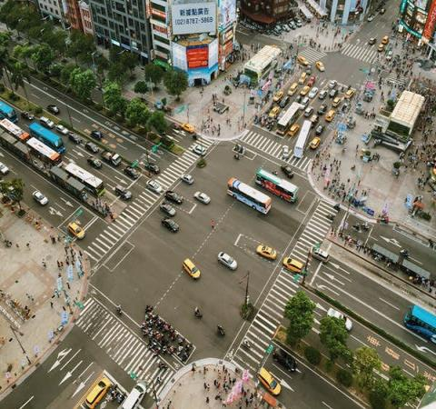





VISIONX
TRAFFIC SIGNAL
TIME OPTIMISATION
Alleviate Traffic Congestion, Enhance Efficiency

Slide 2

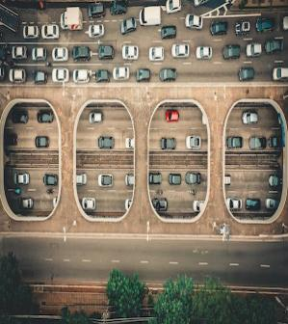

PROBLEM STATEMENT
Optimizing urban traffic signal timings for efficient flow, reduced congestion, and enhanced safety.

Slide 3
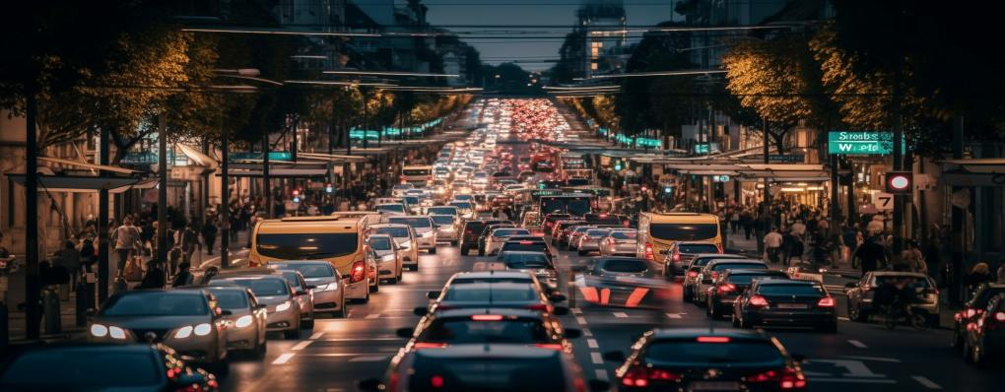
KEY HIGHLIGHTS
Object detection and count
Fine-tuned YOLOv8 model for newer vehicle
Gamified Traffic Control Room
Live Detection of emergency vehicles

Slide 4

PROCESS FLOW
Snapshot of traffic lane
Detecting and counting the no. of vehicles
Calculating the time required for vehicles to cross
Updating the signal timer

Slide 5
TECHNOLOGIES USED
DATA PREPARATION
MODEL
BUILDING
SIMULATION
labelImg
yolov5
pygame
VGG
yolov8
threading
supervision
cv2
detectron2

Slide 6
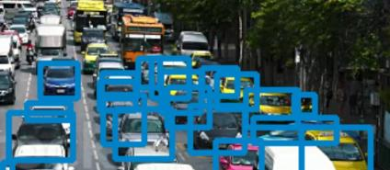
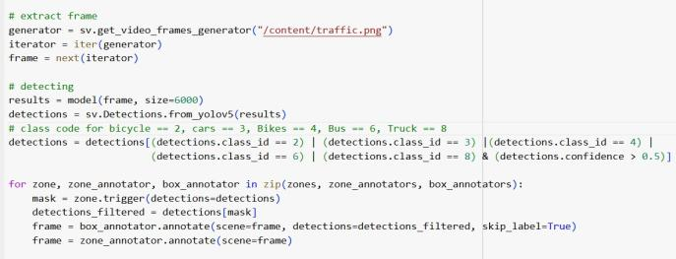
VEHICLE DETECTION MODULE
STEP
1
A YOLOv5 model was trained with pre-trained weights to detect cars and bikes, and this detection capability was employed for traffic signal timing optimization.
Logic was developed for signal switching and calculating the timings.
MODEL
BUILDING

Slide 7
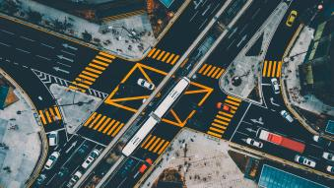
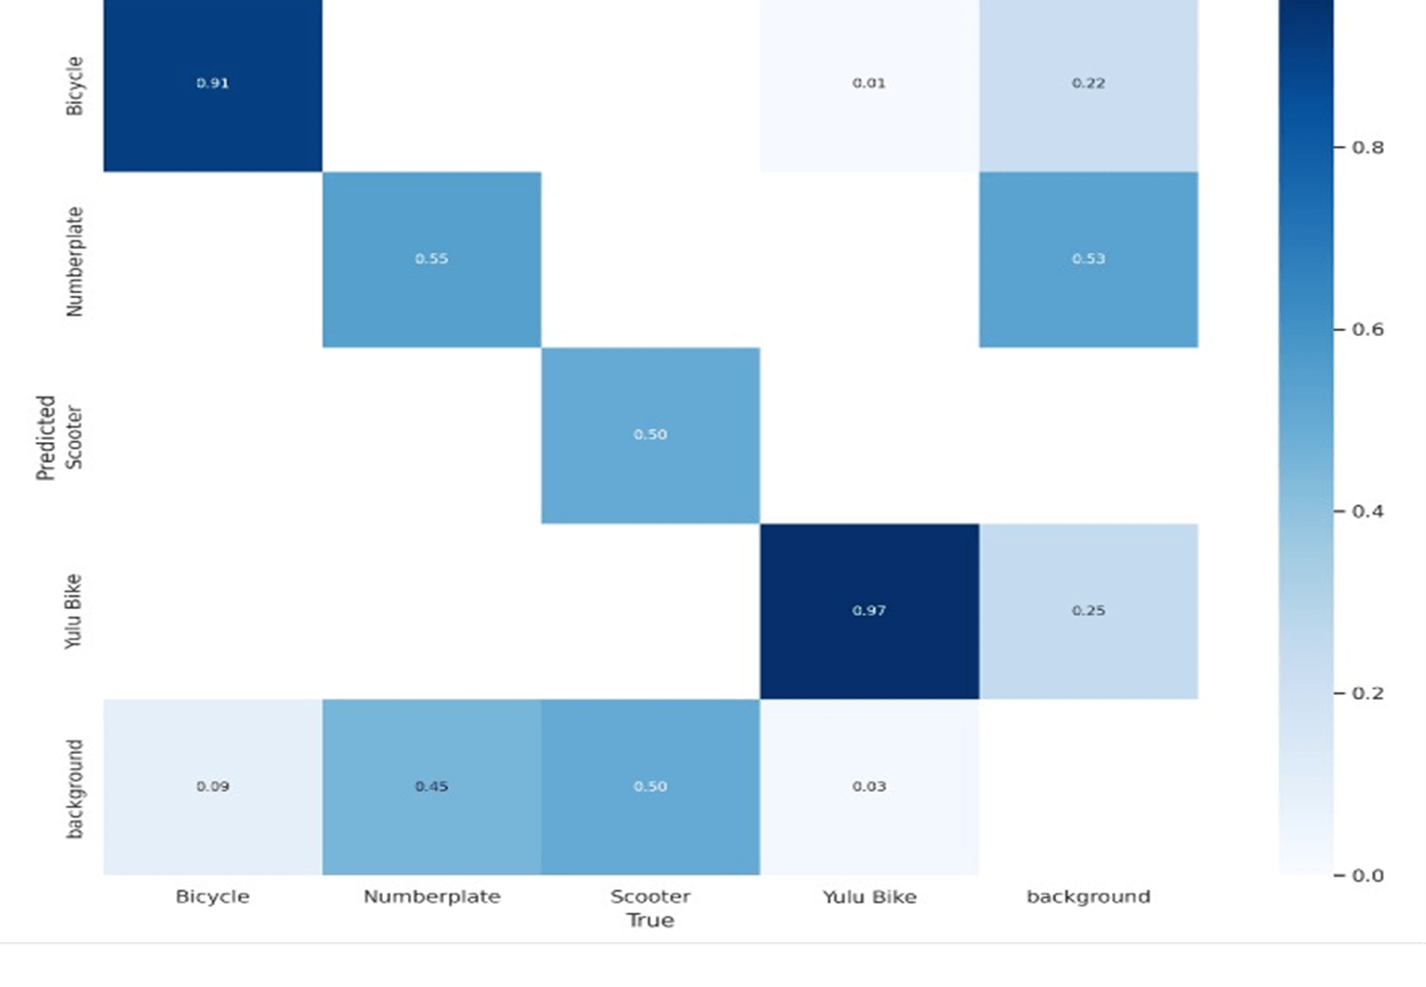

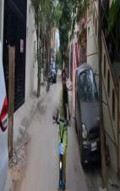
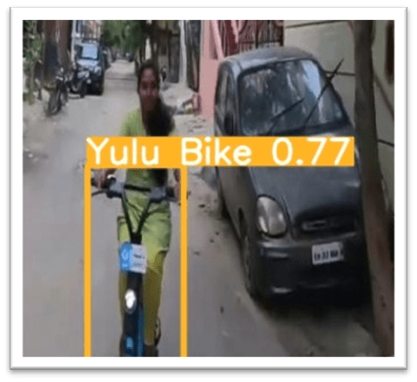
Manually annotated data using tools like LabelImg and VGG, sourced traffic videos from the internet, and employed computer vision platforms like Roboflow.
DATA SOURCES
Custom training data consisting of 6782 images of Yulu bikes, annotated using labeling tools, was used to fine-tune the model.
The model achieved a high accuracy rate of 97% in correctly classifying Yulu bikes.
CUSTOM TRAINING

Slide 8
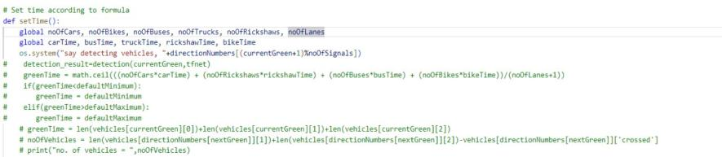
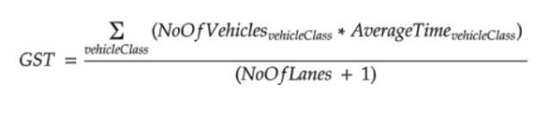
STEP
SIGNAL TIMER MODULE
2
FORMULA
GST: Green Signal Timing
Types of vehicles taken: Cars, Bikes, Trucks, Rickshaw and Yulu
Average time: Time taken by the vehicles to cross the intersection
No. of Lanes: 4 in this case

Slide 9
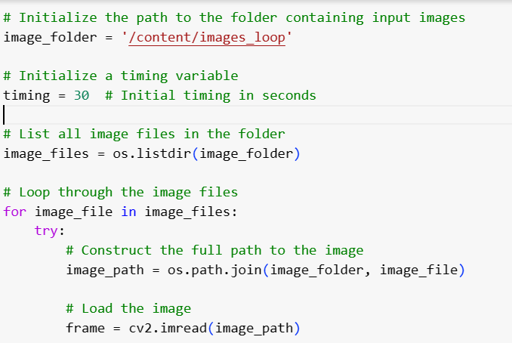
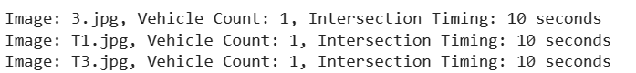
STEP
CONTROL ROOM MODULE
INPUT
3
OUTPUT

Slide 10



DEMO
01
Fixed Timing Simulation
A traffic intersection with 20s timer for each lane
02
Adaptive Timing Simulation
A traffic intersection with different timer for each lane

Slide 11
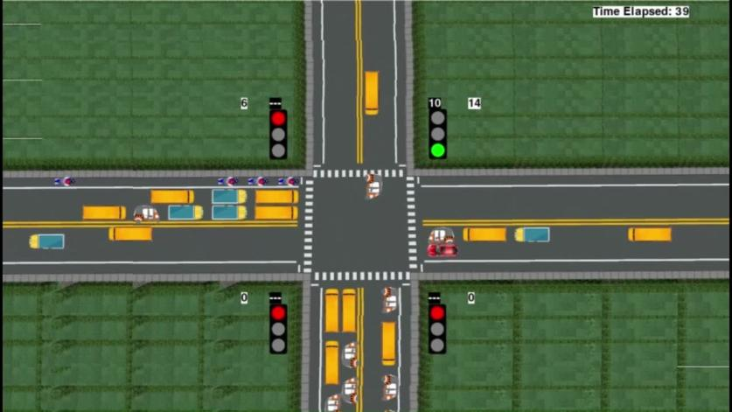
BEFORE MODEL

Slide 12
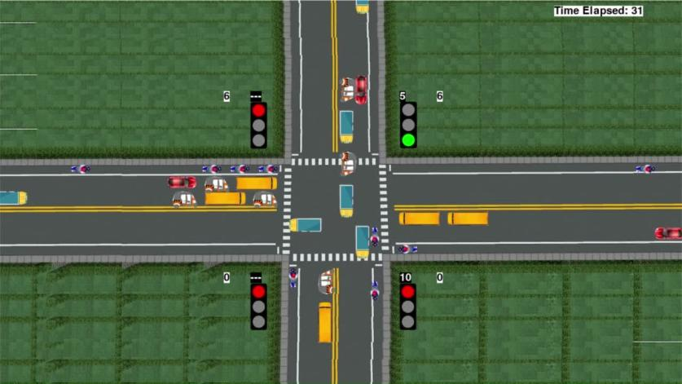
AFTER MODEL

Slide 13
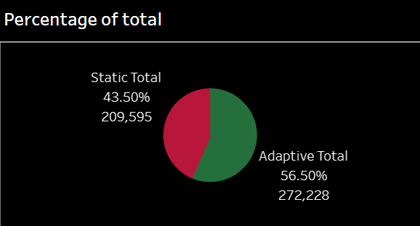
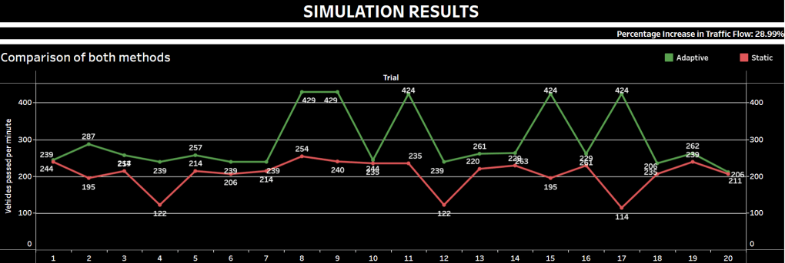
RESULTS
A comparative study of both methods are done and it is found that traffic flow increased by 28.99%.
The Adaptive signal method paved way for more number of Vehicles to pass as compared to Static Method.

Slide 14

CHALLENGES
Gathering and annotating a diverse and extensive dataset proved to be time-consuming task
Creating a comprehensive and accurate simulation code was a complex endeavor, demanding significant technical expertise and effort
Predicting future vehicle behavior was hindered by a lack of available data
Prioritizing emergency vehicles required live feed, increasing costs

Slide 15

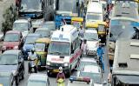
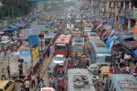

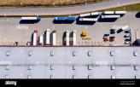
FUTURE SCOPE
1
2
3
4
Adapting to emergency vehicles using reinforcement learning
Predicting future traffic in advance based on past data
Management of traffic within a warehouse
Identify motorbikers without Helmets

Slide 16

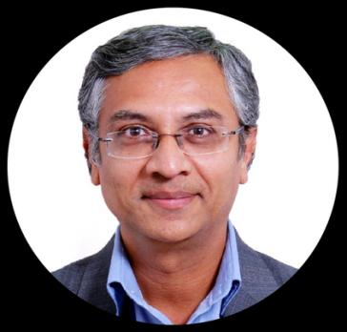
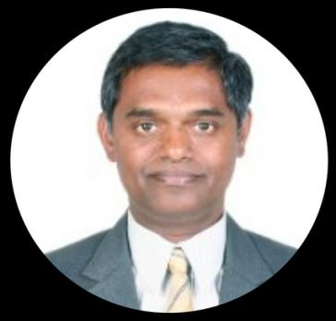
ACKNOWLEDGEMENT
Sincere thanks to:
Sridhar Srinivasan Sir
Regi Mathew Sir
for constant support and guidance

Slide 17
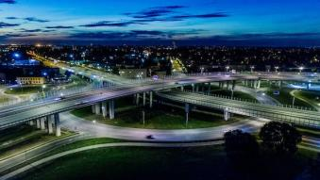




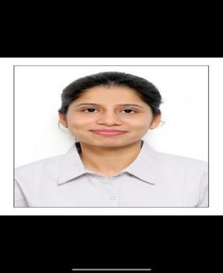
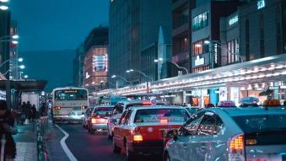
OUR TEAM
Rutvik Kapuriya
Barkha Tyagi
Shraddha Srivastava
Prithvi Raj Maddukuri
Vanshika Kukreja

Slide 18


Slide 19










REFERENCES

